Slide 1


PES INSTITUTE OF TECHNOLOGY AND MANAGEMENT
DEPARTMENT OF MASTER OF COMPUTER APPLICATIONS
PRESENTATION
ON
SECURE FILE STORAGE USING HYBRID CRYPTOGRAPHY
SUBMITTED BY
ULLAS G T
3rd SEM MCA
UNDER THE GUIDANCE OF
Ms. KAVYA H V
ASSISTANT PROFESSOR
PESITM

Slide 2


Secure file storage using hybrid cryptography

Slide 3

INTRODUCTION
In the digital world, protecting files is very important.
Hybrid cryptography helps achieve stronger security by combining the speed of AES and the secure key handling of RSA.
In this project, users can upload, encrypt, store, and retrieve files safely through a simple interface.

Slide 4

Problem statement
Today cyberattacks are increasing, and sensitive files stored on local systems or cloud platforms are at high risk.
Using only symmetric encryption creates key-sharing problems, and using only asymmetric encryption is slow for large files.
So, maintaining both security and performance is a major challenge. This project solves that challenge .

Slide 5
Objectives
To build a secure file storage system.
To combine symmetric AES and asymmetric RSA encryption for strong protection.
To ensure confidentiality, integrity, and authorized access.
To provide a simple interface for users to upload and download files safely.
To improve both security and performance.

Slide 6
Scope and purpose
scope
The system mainly focuses on encryption, decryption, uploading, and retrieving files.
It uses AES for data encryption and RSA for secure key protection.
Purpose
The purpose is to show how hybrid cryptography enhances data safety and makes file handling secure and fast.
It aims to prevent data theft and unauthorized access.

Slide 7
Existing system and disadvantages
In the existing systems, only a single encryption method is used.
Symmetric encryption is fast but unsafe for key sharing.
Asymmetric encryption is secure but slow for large files.
This creates limitations in security and performance.
disadvantages
Single encryption is easier to break.
Key management becomes risky.
Slow performance with large files.

Slide 8

Proposed system and advantages
Our proposed system uses hybrid cryptography.
AES encrypts the file quickly, and RSA encrypts the AES key securely.
This ensures confidentiality and integrity.
The system also provides a simple interface for users to upload and download encrypted files.
advantages
Fast encryption & decryption.
Prevents unauthorized access.
Strong data protection.
User-friendly interface.

Slide 9
Hardware and software requirements
software requirements
Operating System : Windows 11
Programming Language : Python
Development Environment : VS Code
Libraries : Flask
hardware requirements
Processor : Ryzen 7
RMA : 8 GB
Hard Disk : 512 GB SSD

Slide 10
Functional Requirements
User can upload and download files.
User can register and log in securely.
System will encrypt files using AES before storage.
RSA encryption will secure the AES key.
User can decrypt files after authentication.
System ensures data integrity and access control.
Admin can monitor user activities and file logs.

Slide 11
Non Functional Requirements
Security: Protect user data using strong encryption methods.
Performance: Ensure fast encryption, decryption, and file transfer.
Usability: Provide a simple and user-friendly interface.
Reliability: System should work smoothly without data loss.
Scalability: Handle multiple users and large files efficiently.
Availability: Ensure continuous access to stored files.
Maintainability: Easy to update and improve the system.

Slide 12
Algorithms and technology used
Algorithms :
Advanced Encryption Standard (AES):
  Used for fast and secure file encryption/decryption.
  Ensures data confidentiality with symmetric key encryption.
Rivest–Shamir–Adleman(RES):
  Used to encrypt and protect the AES key.
  Provides secure key exchange using asymmetric encryption.
Hybrid Approach:
  Combines AES and RSA to achieve both speed and high security.
  AES encrypts data → RSA encrypts AES key → Secure storage.

Slide 13
technology
High-Level Language : Python is easy to read, write, and understand.
Interpreted Language : Code runs line by line, making debugging simple.
Open Source : Free to use and supported by a large community.
Used in Many Fields : Commonly used in web development, data science, machine learning, and automation.
Used in Many Fields : Commonly used in web development, data science, machine learning, and automation.

Slide 14
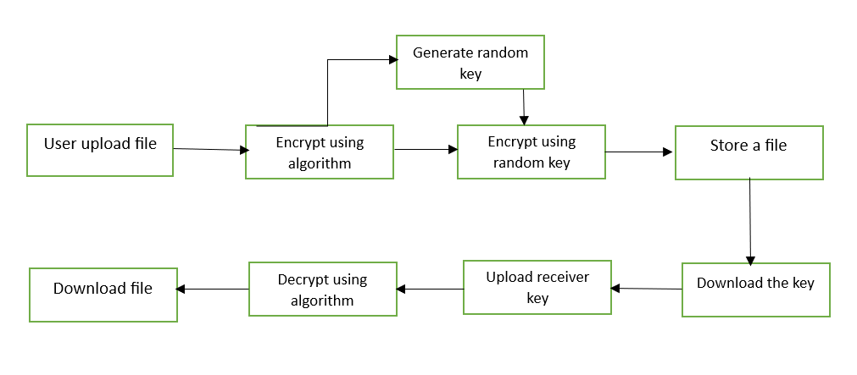
System design

Slide 15
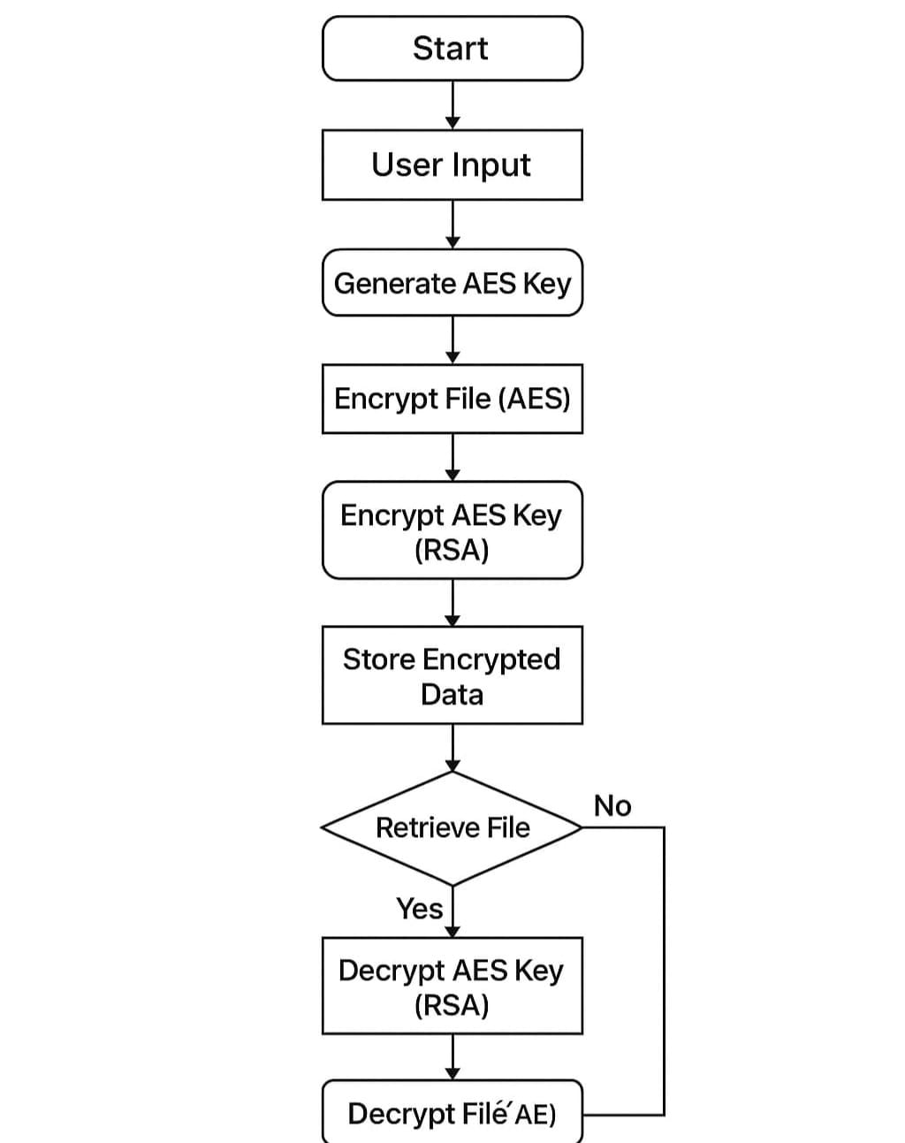
Data flow diagram

Slide 16
Thank
you

